Slide 1

Harvest hub
SSVPS’s BAPUSAHEB SHIVAJIRAO DEORE COLLEGE OF ENGINEERING AND TECHNOLOGY, DHULE
B.Tech (Final Year)
Computer Department
Group Members:
1.Kamini Sharad Patil
2.Chetana Motilal Patil
3.Mayuri Dipak Bhamare
4.Prachi Sitaram Nikam
Group No: 5
Guide : Mrs. B. D. Patil
Notes:
NOTE:
To change the image on this slide, select the picture and delete it. Then click the Pictures icon in the placeholder to insert your own image.

Slide 2
CONTENT
INTRODUCTION
PROBLEM STATEMENT
SYSTEM BLOCK DIAGRAM
METHODOLOGY
PHASES
ADVANTAGES
APPLICATIONS
CONCLUSION
REFERENCES

Slide 3
INTRODUCTION
India being 3 largest area in Asia has 2 largest population. It is the leading producer of agriculture products Agriculture is the main occupation of Indian people. Agriculture has a sound tone in this competitive world. Many areas Farming acts as major source of occupation.
Agriculture directly depends on the environmental factors such as sunlight, humidity, soil type, rainfall. Maximum and Minimum Temperature, climate, fertilizers, pesticides etc. Knowledge of proper harvesting of crops is in need to bloom in Agriculture.
Proposed model predict crop based on rainfall, temperature, humidity and soil moisture. Dataset is pre-processed and converted to numerals before training and prediction . There are three techniques applied for prediction SVM and logistics regression is used.
Intelligence of applying modern technological methods in the field of agriculture is desirable in this current scenario. Machine Learning Techniques develops a well-defined model with the data and helps us to attain predictions Agricultural issues like crop prediction, rotation, water requirement, fertilizer requirement and protection can be solved.

Slide 4
PROBLEM STATEMENT
The production of agriculture is affected by several climate factors. Like as metrological parameters (Humidity, wind speed, temperature, and moisture), precipitation parameters (rainfall, region wise rainfall, irrigation etc. And due to continuously change in climate condition everything is messed.
In India farmers still follow the traditional technology which they adopted from their ancestor. But the problem is that in earliest time climate was very healthy everything was happened on time. But now most of the things have been changed due to global warming and many other factors.
The main problem with agriculture in India is lack of rainfall in seasonal time.

Slide 5
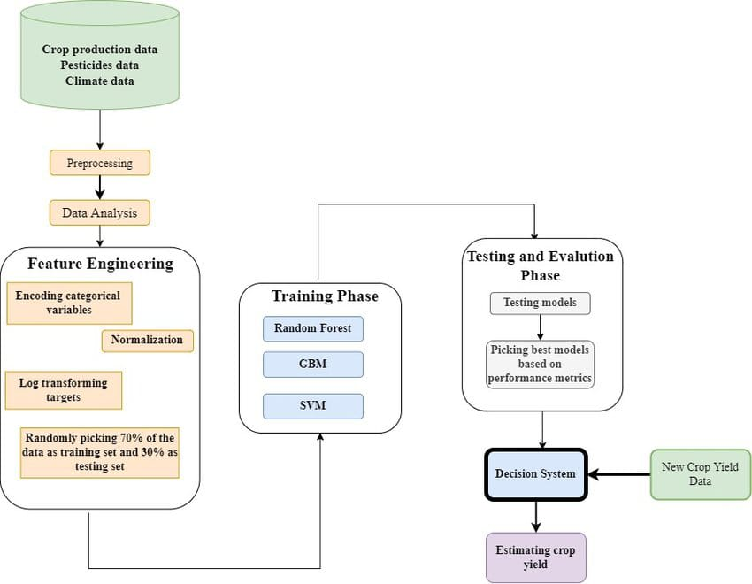
SYSTEM BLOCK DIAGRAM

Slide 6
METHODOLOGY
CROP YEILD PREDICTION
By analyzing the soil and atmosphere at particular region best crop in order to have more crop yield and the net crop yield can be predicted. This prediction will help the farmers. To choose appropriate crops for their farm according to the soil type, temperature, humidity, water level, spacing depth, soil PH, season, fertilizer and months.
FERTILIZER PREDICTION
India is a highly populated country and randomly change in the climatic conditions need to secure the world food resources. Farmers face serious problems in drought conditions. Type of soil plays a major role in the crop yield. Suggesting the use of fertilizers may help the farmers to make the best decision for their cropping situation.
.

Slide 7
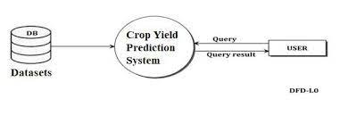
1. DATA COLLECTION
PHASES
In this module datasets are collected from various sources like GKVK, DES and agmarknet.gov.in. The datasets include information like temperature, rainfall, price. area, production and yield of the previous 5 years.

Slide 8
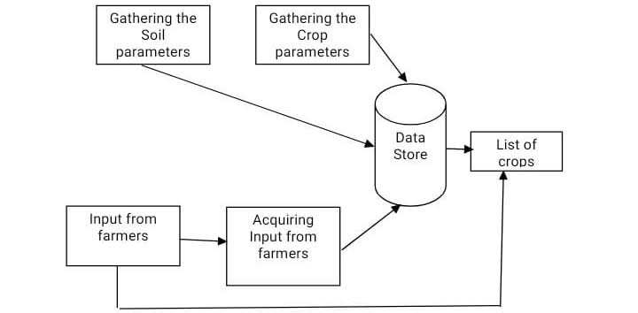
2.DATA PRE-PROCESSING
.
Data pre-processing includes removing of the unwanted attributes from our datasets. Feature extraction is done in order to extract only the attributes that affect the price and yield of a crop like rainfall, temperature, location, area, production and yield

Slide 9
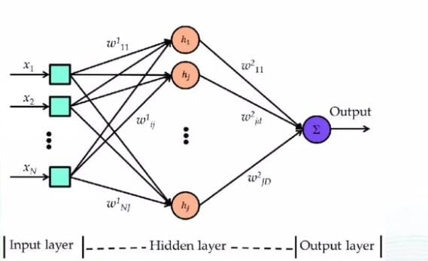
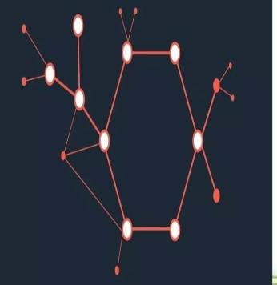
3.ANALYSIS AND PREDICTION
In this module, patterns in data is recognized, percentage correlation between various factors affecting crop yield and price are determined. Various data visualization techniques are used to study the patterns in data and factors causing change.
Algorithms like Multiple Linear Regression and Random Forest are used to predict crop yield and price. The accuracy of these algorithms are compared using mean absolute percentage error thus helping us determine the most suitable approach for prediction.

Slide 10
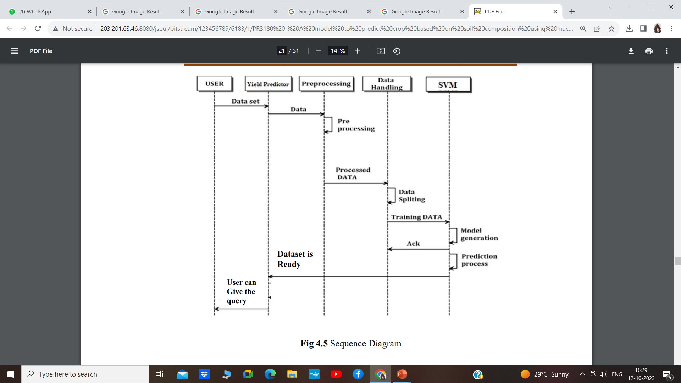
FIG: SEQUENCE DIAGRAM

Slide 11
ADVANTAGES
Time consumption is reduced.
Fertilizer is suggested.
It helps farmers make informed decisions about planting, harvesting, and resource allocation.
It also enables better management of crop diseases, pests, and weather-related risks.
Manual is reduced.
Accuracy is increase.
Less effort.
High reliability.

Slide 12
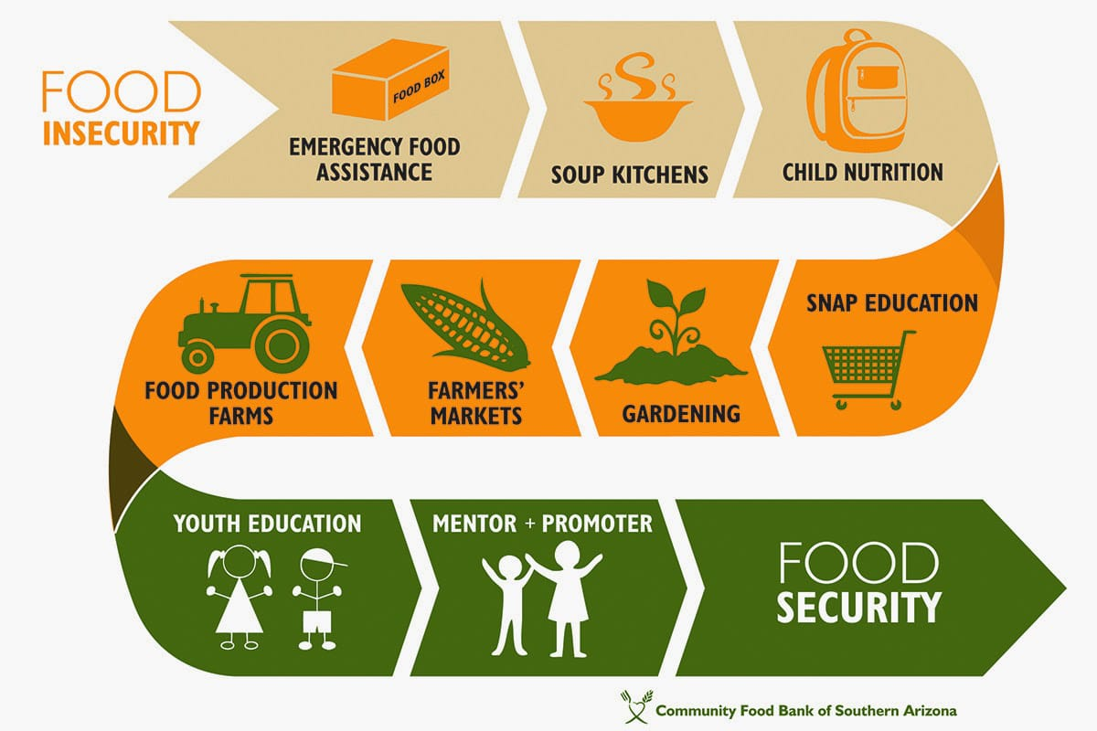


APPLICATIONS
FOOD SECURITY
CLIMATE CHANGE
FINANCIAL PLANNING

Slide 13
CONCLUSION
The method was created with the aim to overcome three obstacles. The first one is to find the effective amount of rainfall the second being to use the effective rainfall to find the irrigation water required and third to suggest suitable crop that should be implemented by the farmers to increase crop productivity. The method is successful in all three aspects and in the future it is expected to bring more areas: under inspection and also bring more crops into the picture.

Slide 14
REFERENCES
[1] N.G.Dastane, Natural Resources Management and Environment Department," Effective rainfall in irrigated agriculture", Food and Agriculture Organization of the United Nations publications, 1978 .
[2] C. Brower, M.Heibloem" Irrigation Water Management: Irrigation water needs... Food and Agriculture Organization of the United Nations publications,1986
[3] Natural Resources Management and Environment Department." Effective rainfall in irrigated agriculture. Food and Agriculture Organization of the United Nations publications,1978
[4] Dr S. Santhosh Baboo and 1. Khadar Shareef, "An efficient Weather Forecasting Model using Artificial Neural Network", International Journal of Environmental Science and Development, Vol.1.No.4.October2010

Slide 15
Thank You !!
.

